Slide 1

Experiential Learning
Phase-2
Title : AI Resume Insight: Intelligent Analysis for Career Growth
Prajwal CS-1RV23IS085
R Abhi-1RV23IS097

Slide 2


Agenda
Introduction to Topic
Topic relevance to courses
Literature Review
Motivation
Problem identification in relevant area/topic
Problem Formulation
Objectives
References

Slide 3
Introduction to Topic
-In today’s competitive job market, resume screening and skill assessment play a crucial role in hiring decisions. Many job seekers face rejection due to poorly structured resumes, lack of keyword optimization, and low ATS compatibility. Additionally, recruiters receive thousands of applications, making AI-driven automation essential for improving hiring efficiency.
-This project proposes an AI-powered Smart Resume Analyzer that evaluates resumes based on ATS compliance, formatting, keyword optimization, and overall strength. It also integrates a coding assessment system to test the technical skills of job seekers. The system predicts job opportunities based on resume quality and coding performance, providing personalized recommendations and career improvement suggestions.

Slide 4
Topic relevance to courses
📡 Computer Networks:
HTTP & WebSockets – Used for real-time resume analysis, coding assessment, and leaderboard updates.
Cloud Computing & API Integration – Stores resumes securely and connects with job databases (LinkedIn, Indeed, etc.).
Data Transmission & Security – Ensures secure user authentication and encrypted resume storage.
🔢 Discrete Mathematics:
✔ Set Theory & Logic – Used in resume keyword matching and applicant-job compatibility scoring.
✔ Probability & Statistics – Helps in job prediction models based on resume strengths and market trends.
✔ Graph Theory – Can be applied for network-based job recommendations using graph traversal algorithms.
✔ Boolean Algebra – Used in decision-making algorithms for evaluating resume strength and coding scores.
Where it is Implemented?
🔹 Graph theory concepts help create an AI-driven recommendation engine for job predictions.
🔹 Statistical modeling ensures accurate ATS and job-fit scoring.

Slide 5
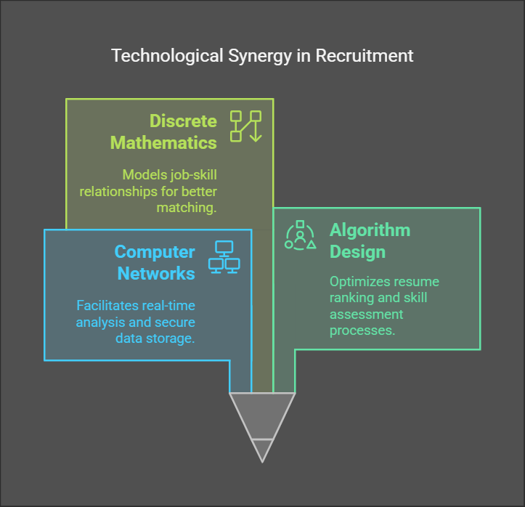
📊 Design and Analysis of Algorithms (DAA):
Time and Space Complexity Analysis – AI assesses coding solutions based on execution time and memory usage.
Sorting & Searching Algorithms – Used in resume ranking, job prediction, and leaderboard management.
Dynamic Programming & Greedy Algorithms – Used to evaluate optimal resume keyword selection and skill improvement pathways and maximize ATS score

Slide 6

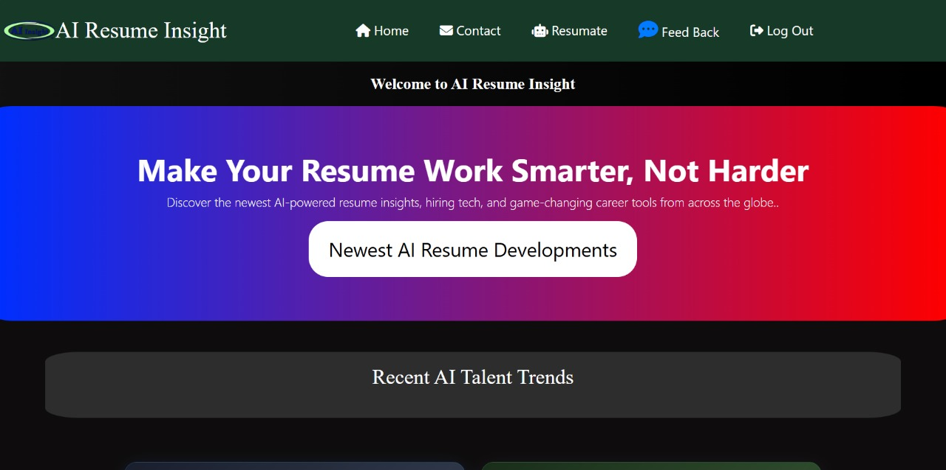
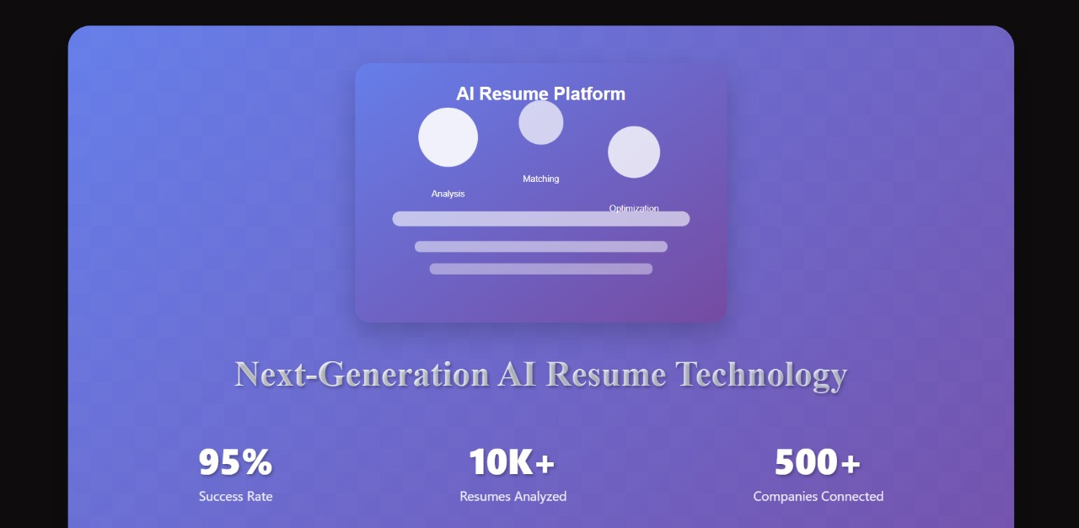
PROTOTYPE

Slide 7

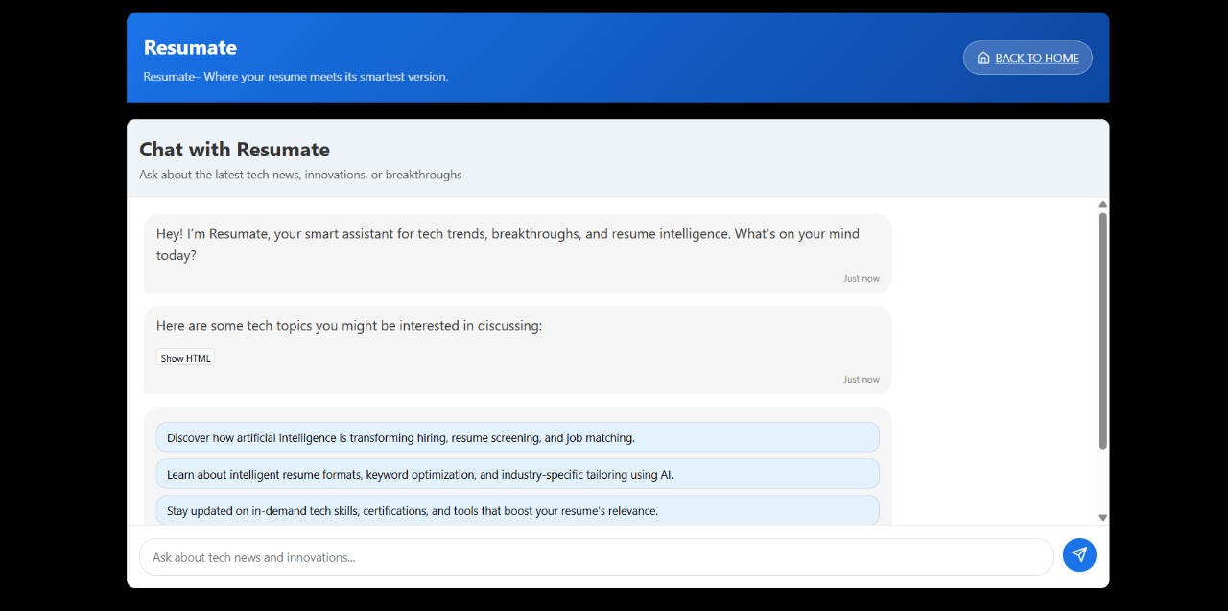

Slide 8
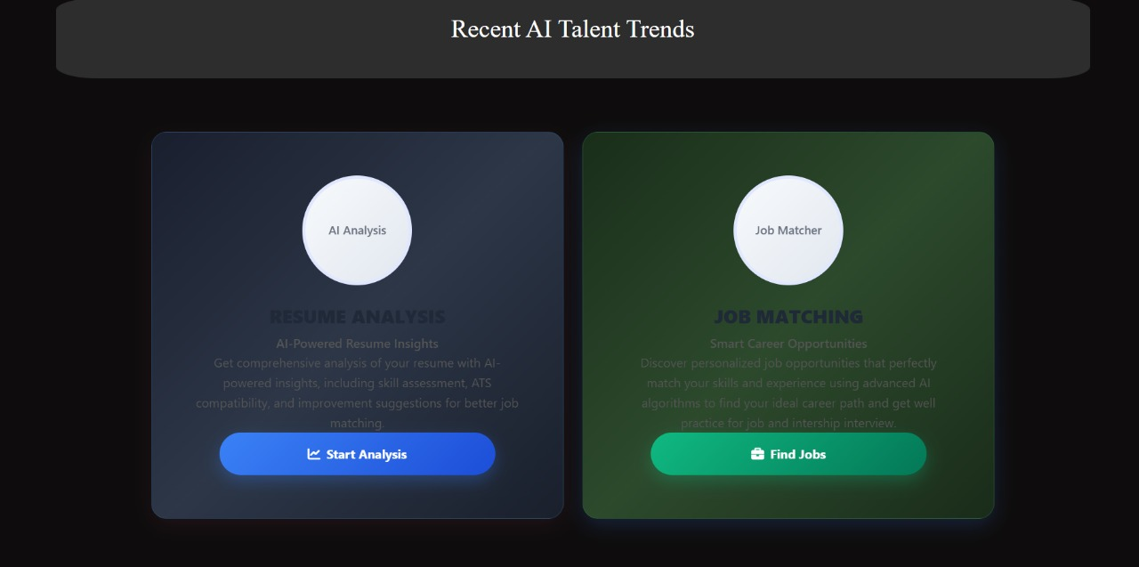
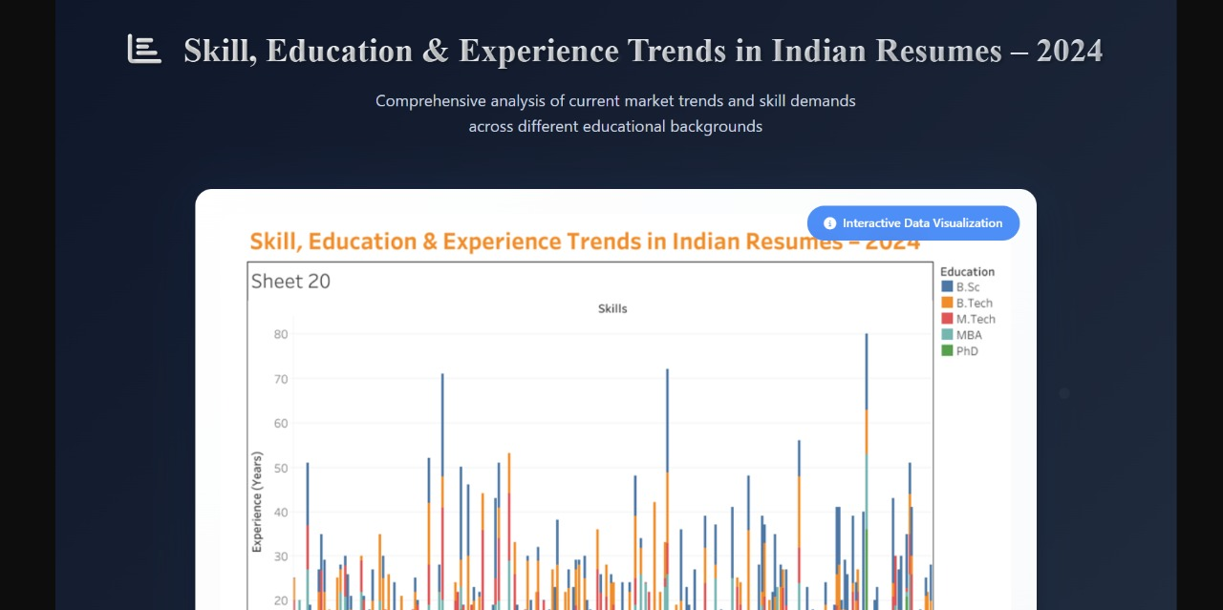

Slide 9
Literature Review
Sl. No 1. 2. 3. | year 2018 2019 2020 | Author Singh et al Patel et al Goyal et al | Title Boolen Algebra for ATS Resume Filtering. Machine Learning for Job Match Prediction. Improving Resume ATS Compatibility through Formatting. | Methodology Used Boolean search techniques to optimize resume filtering in ATS systems. Implemented an SVM-based job recommender system to predict job suitability. Researched the impact of resume structuring on ATS ranking using data from 1000+ resumes. | Findings Resumes optimized with Boolean logic had a 20% higher ATS ranking. Achieved an 72% accuracy rate in job role predictions based on resume content. Well-structured resumes had a 35% higher ATS acceptance rate.

Slide 10
4. 5. 6. 7. | 2021 2022 2022 2023 | Ramesh et al Sharma et al Chen & Liu Dutta et al | Deep Learning for Resume-Job Compatibility. AI-Driven Resume Skill Recommendations. Graph-Based Skill Matching for Resume Analysis. Smart Resume Kiosk using IoT and NFC Technology. | Used LSTM and BERT models to analyze resume-job compatibility for job recommendations. Analyzed job market data and suggested personalized skills & certifications using AI. Designed a Bipartite Graph Matching Model for skill-based job matching. Designed a resume submission kiosk that allows NFC-enabled instant resume transfer. | Used LSTM and BERT models to analyze resume-job compatibility for job recommendations. Candidates following AI recommendations improved their job suitability by 25%. Increased the accuracy of job recommendations by 32%. Reduced paper-based resume use by 60% at job fairs and hiring events.

Slide 11
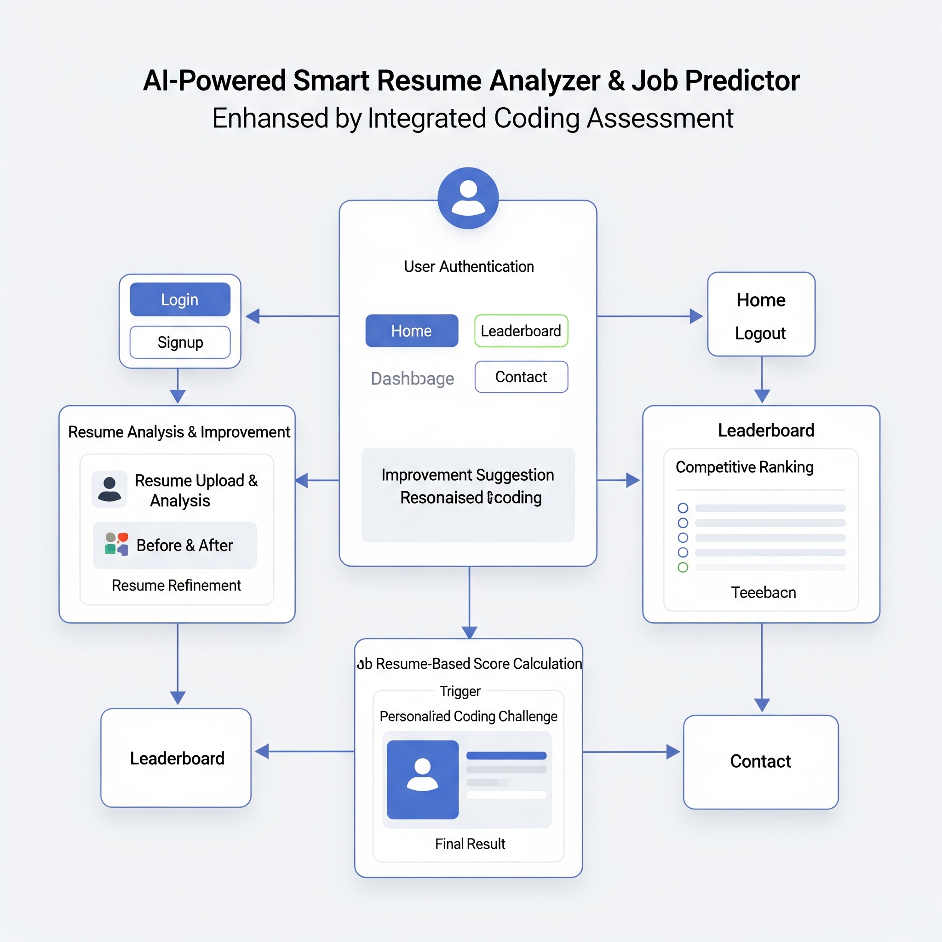

Slide 12
Motivation
In today's competitive job market, many resumes are rejected due to poor ATS compatibility, improper formatting, and missing industry-specific keywords. Traditional resume screening is inefficient, and candidates often struggle with job-role alignment and technical assessments. Many job seekers lack guidance on improving their resumes and coding proficiency, reducing their chances of securing interviews. This AI-powered system analyzes resumes, evaluates coding skills, and provides personalized job recommendations. By leveraging AI-driven insights, it enhances resume quality, boosts ATS scores, and helps candidates align their skills with industry demands, ultimately increasing job readiness, interview success rates, and career growth opportunities.

Slide 13
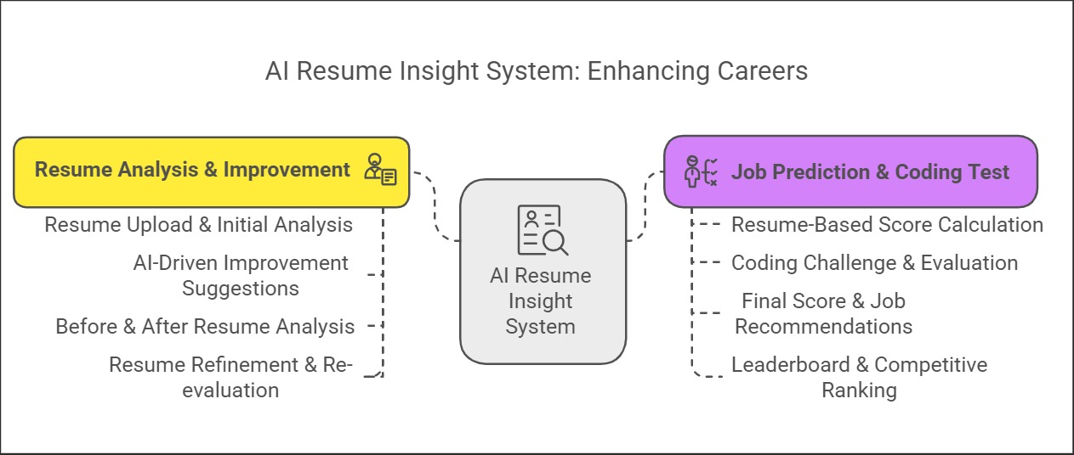
FLOW DIAGRAM
.

Slide 14
Problem identification in relevant area/topic
1)Resume Optimization Challenges:
🔹 Low ATS Compatibility – Many resumes fail to pass Applicant Tracking Systems (ATS) due to improper formatting and missing keywords.
🔹 Lack of Personalization – Generic resumes don’t align well with specific job descriptions, reducing selection chances.
🔹 Poor Resume Structuring – Many applicants struggle with professional formatting and readability, leading to rejections.
2)Job Search & Application Struggles:
🔹 Inefficient Job Matching – Candidates apply to random job postings without knowing which jobs best fit their profile.
🔹 Lack of AI-Driven Job Recommendations – Most platforms provide generic job suggestions, not tailored based on skills and resume content.
🔹 Manual Effort in Resume Improvements – Job seekers spend hours modifying resumes without professional guidance.

Slide 15
3)Coding Skill Assessment Gaps:
🔹 No Pre-Evaluation of Coding Skills – Many applicants are unaware of their technical strengths and weaknesses before an interview.
🔹 Lack of AI-Based Coding Feedback – No automated system provides feedback on coding correctness, efficiency, and logic.
🔹 Limited Preparation for Technical Rounds – Candidates do not get a realistic coding challenge experience before job interviews.
4)Lack of a Centralized Career Development Platform:
🔹 Scattered Tools & Resources – Resume analysis, job recommendations, and coding tests are spread across multiple platforms, making it hard for job seekers to track progress.
🔹 No Integrated AI-Driven Career Guidance – Most job portals don’t offer an all-in-one solution combining resume analysis, skill improvement, job prediction, and coding evaluation.

Slide 16
Problem Formulation
💡 "Many job seekers struggle to create an optimized resume that passes ATS screening and showcases their skills effectively. Additionally, assessing technical competency for job applications requires coding evaluations, which are often missing in traditional hiring processes."
1)Lack of Personalized Resume Feedback:
-Job seekers do not get real-time, AI-driven improvement suggestions to enhance their resumes.
-Manual improvements take time and effort, with no guarantee of success.
2)No AI-Based Job & Internship Matching:
-Most job seekers rely on random applications instead of targeted job suggestions based on their profile.
-Lack of smart job recommendations based on AI predictions.

Slide 17
3)Coding Skills Evaluation Gap:
-Many companies assess technical skills through coding tests, but candidates lack pre-evaluation before actual interviews.
-No automated system evaluates coding correctness, efficiency, and problem-solving ability.
4)No Competitive Benchmarking (Leaderboard):
-Candidates don’t have a performance ranking system to assess how they compare to peers.
-No motivation mechanism to improve skills and resume strength.

Slide 18
Project Objectives
1)To Enhance Resume Quality & ATS Compatibility.
2)To provide Personalized Resume Improvement Suggestions.
3)To develop AI-Based Job Role & Internship Predictions.
4)To gamify Gamified Skill Evaluation – Coding Test & Leaderboard.
5)To ensure a Seamless User Experience & Engagement.
6)To build a Secure & Scalable Platform.

Slide 19
References
[1]V. Nawander, S. Elma, A. Karthikeya, M. K. Yadav, S. K. Kotala, M. D. N. Akash,Intl. Res. J. Engg. Tech 9, 10 (2022)
[2] A. K. Sinha, A. K. Akhtar, A. Kumar, Resume Screening Using Natural LanguageProcessing and Machine Learning: A Systematic Review. In: Swain, D., Pattnaik, P.K.,Athawale, T. (eds) Machine Learning and Information Processing. Advances in Intelligent Systems and Computing, Springer, Singapore, 1311 (2020)
[3]R. P. Ram Kumar, P. Sanjeeva, Intl. J. Recent Tech Engg 7, 5 (2019)
[4] M. N. Mohammad, Ch. U. Kumari, A. S. D. Murthy, B. O. L. Jagan, K. Saikumar,Mater. Today Proc. 45 (2021)
[5]B. Sankara Babu, S. Nalajala, K. Sarada, V. Muniraju Naidu, N. Yamsani, K.Saikumar, Machine Learning based online Handwritten Telugu Letters Recognition for Different Domains, in Proceedings of A Fusion of Artificial Intelligence and Internet of Things for Emerging Cyber Systems, P. Kumar, A. J. Obaid, K. Cengiz, A. Khanna,
[6]M. Thejaswee, V. Srilakshmi, K. Anuradha, G. Karuna, Performance Analysis ofMachine Learning Algorithms for Text Classification, in Proceedings of the Advanced Informatics for Computing Research (ICAICR 2020), A. K. Luhach, D. S. Jat, K. H.Bin Ghazali, Gao, P. Lingras, (eds), Comm. Comp. Inform. Sci. Springer, Singapore 1393 (2021)

Slide 20
[7] R. P. Ram Kumar, P. Sanjeeva, S. F. Lazarus, D. V. Krishna, Intl. J. Inno. Tech.Explor. Engg 8, 11S2 (2019)
[8] Thimma Reddy Kalva, Utah State University,2013. Skill-Finder: Automated Job-Resume Matching system. 3]Yong Luo, Nanyang Technological University, 2018. A Learning-Based Framework for automatic resume quality assessment, arXiv:1810.02832v1 cs.IR]..
[9] Arvind Kumar Sinha, Ashwani Kumar, Md. Amir Khusru Akhtar., Resume Screening using Natural Language Processing and Machine Learning a Systematic Review”, (2019)., Machine Learning and Information Processing: Proceedings of ICMLIP
[10] Suhas H E, Manjunath AE, “Differential Hiring using a Combination of NER and Word Embedding”, In 2020 International Journal of Recent Technology and Engineering (IJRTE), ISSN: 2277-3878, Vol.9.
[11] Y. Luo, Y. Wen, T. Liu, and D. Tao, “Transferring knowledge fragments for Learning distance metric from a heterogeneous domain,” IEEE Transactions on Pattern Analysis and Machine Intelligence, 2018
[12] Sujit Amin; Nikita Jayakar; Sonia Sunny; Pheba Babu; M. Kiruthika; Ambarish Gurjar, “Web Application for Screening Resume”, 2019 International Conference on Nascent Technologies in Engineering (ICNTE), January 2020
[13]Rajath V; Riza Tanaz Fareed; Sharadadevi Kaganurmath, “Resume Classification and Ranking Using KNN And Cosine Similarity”, international JOURNAL OF ENGINEERING RESEARCH & TECHNOLOGY, Volume 10, Issue 08, AUGUST 2021

Slide 21


